Slide 1
BREL
BHARAT RENEWABLE ENERGY LIMITED
BHARAT RENEWABLE ENERGY LIMITED

Slide 2
BREL
PROCESSES INVOLVED
BHARAT RENEWABLE ENERGY LIMITED
Wasteland Identification from District level land records
Liaise with the block officials to verify wasteland data for biofuel plantation under Jeevan Jyoti Pariyojna
Execution of Land and Buyback agreement with Gram Panchayats
Inclusion of the project in Karya Yojana at block level
Challenge - biofuel plantation finds a low priority among other projects under Jeevan Jyoti Pariyojna

Slide 3
BREL
FUND RELEASE BOTTLENECKS
BHARAT RENEWABLE ENERGY LIMITED
Submission of Fund estimates for plantation
Takes its due course - bottlenecks in fund release
Approx 30% of land area included in Karya Yojana gets converted for Plantation

Slide 4
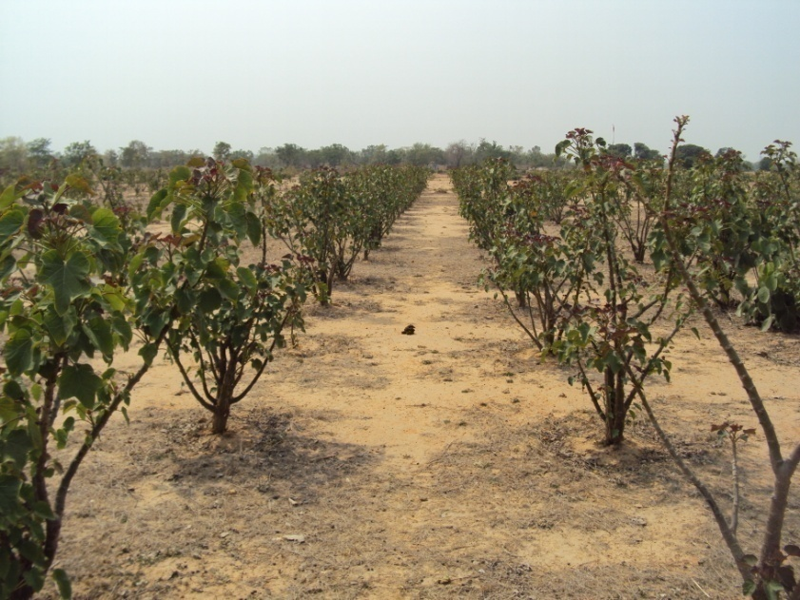
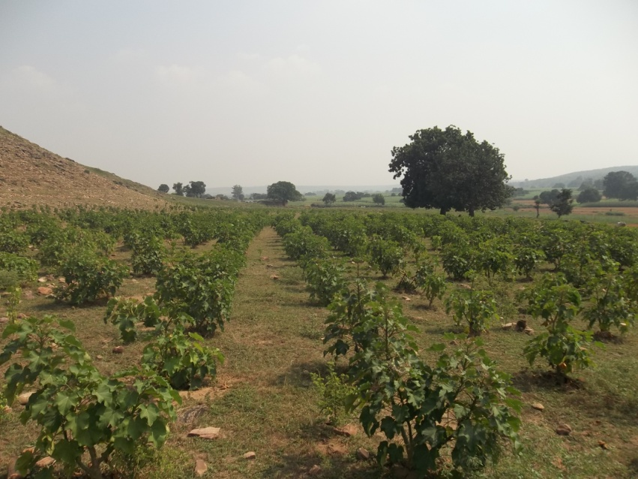
BREL
PLANTATION PROGRESS SO FAR
BHARAT RENEWABLE ENERGY LIMITED
Plantation across 20 districts of UP in multiple agro-climatic conditions and soil types in last 3 years
Survival and yield of these plantations varies across different locations

Slide 5
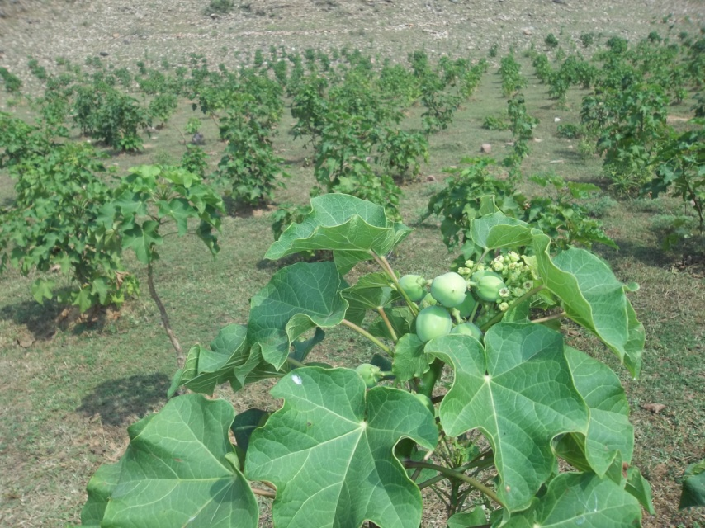
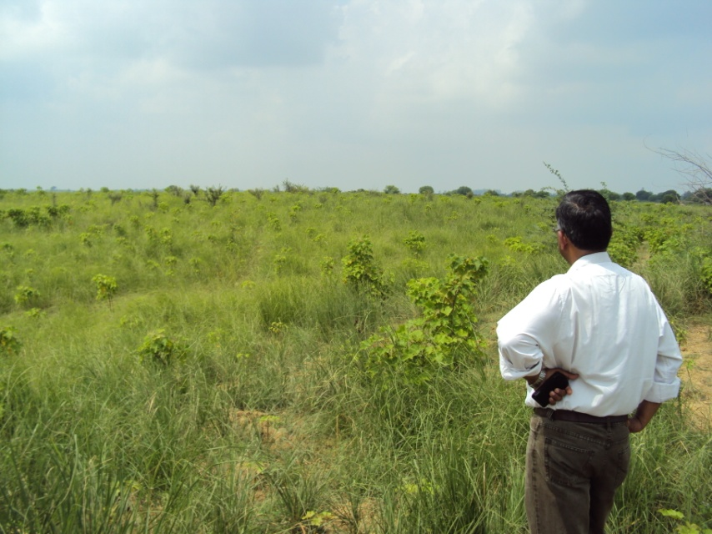
BREL
PLANTATION PROGRESS SO FAR
BHARAT RENEWABLE ENERGY LIMITED
Its viability is still being tried and tested, R&D trials at various plantation locations

Slide 6
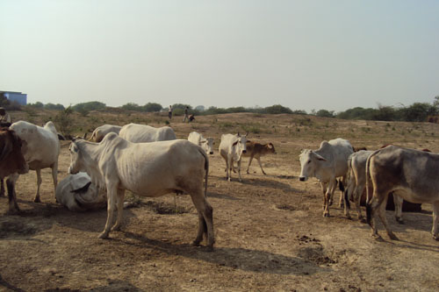
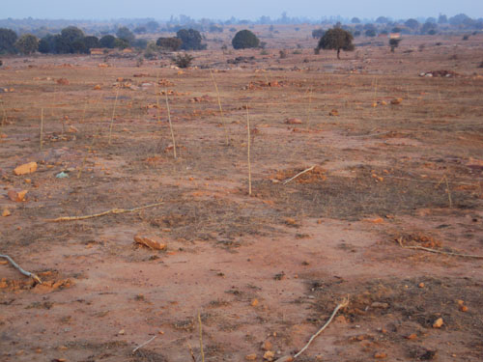
BREL
CHALLENGES
BHARAT RENEWABLE ENERGY LIMITED
After care of the plantation
(uncared baby)
Ownership crisis
Survival and yield is compromised
Lack of awareness and interest among rural masses about benefits of biofuel plantation in terms of income, livelihood, employment and fulfillment of basic needs of power and electricity

Slide 7
BREL
BHARAT RENEWABLE ENERGY LIMITED
PLANTATION PLAN FOR THIS YEAR
Biofuel Plantation on 23000 acres land across 27 districts of UP
Included in this year’s Karya Yojana
Significant Pongamia plantation planned this year

Slide 8
BREL
BHARAT RENEWABLE ENERGY LIMITED
BIO ENERGY COMMITTEES
District level Bio-energy committees formed this year – will boost in overcoming existing bottlenecks and aligning fund release process

Slide 9
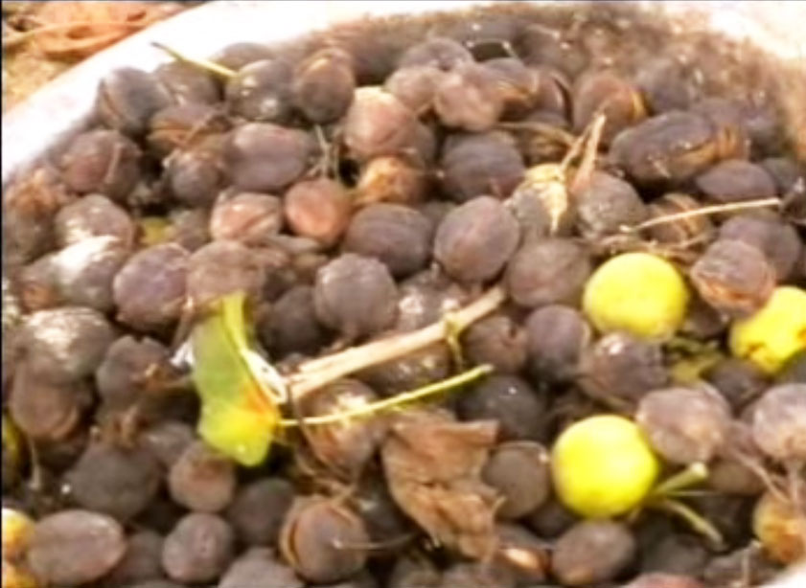
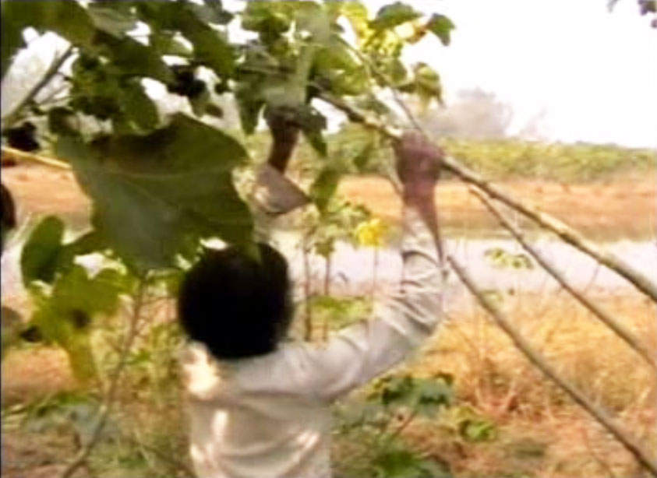
BREL
BHARAT RENEWABLE ENERGY LIMITED
HARVEST & PROCUREMENT
BREL first harvest last year
Actively begun aggregation and procurement of feedstock

Slide 10
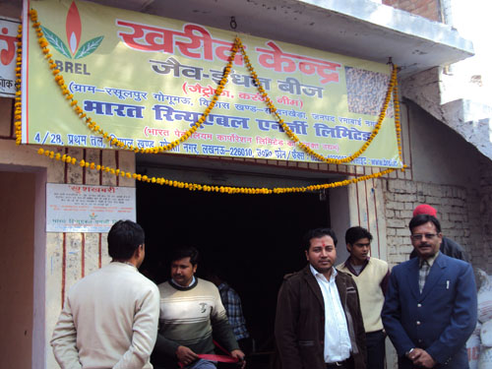
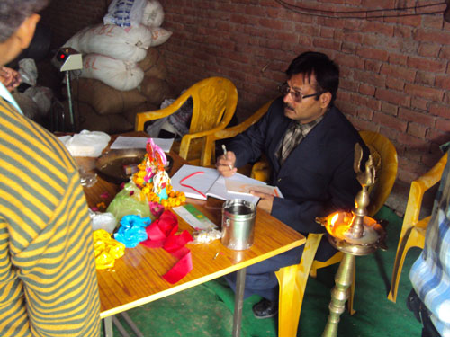
BREL
BHARAT RENEWABLE ENERGY LIMITED
COLLECTION CENTRE
Collection Centre at Kanpur Dehat

Slide 11
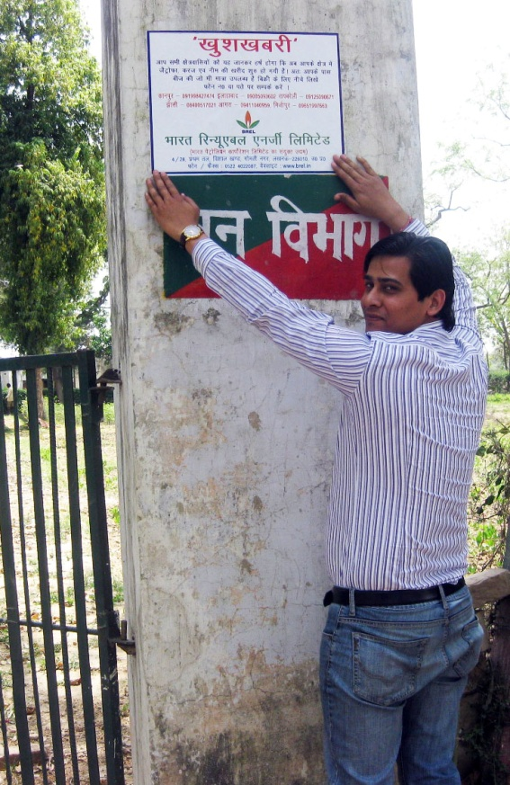
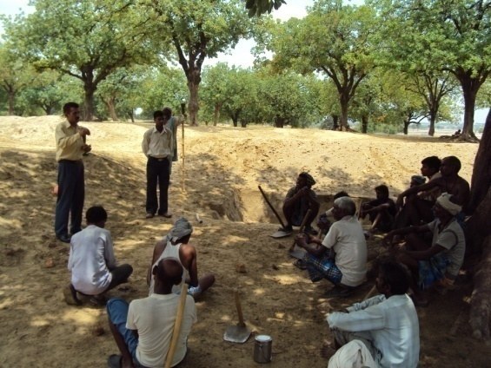
BREL
AWARENESS CAMPAIGNS
BHARAT RENEWABLE ENERGY LIMITED
Capacity building, awareness campaigns, banners, posters to guide, sensitize and mobilize the rural masses for feedstock aggregation

Slide 12
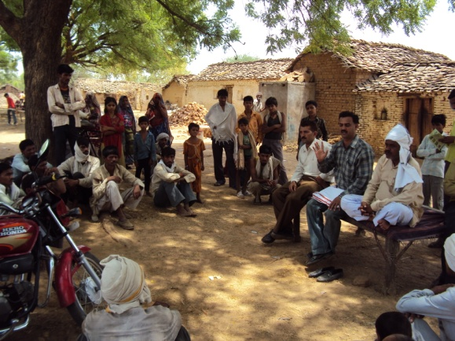
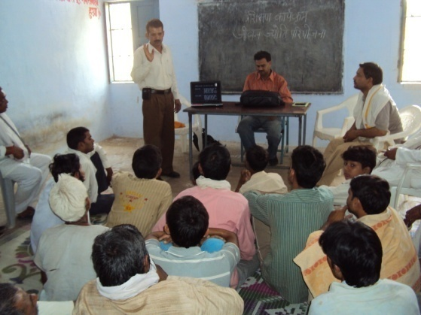
BREL
AWARENESS CAMPAIGNS
BHARAT RENEWABLE ENERGY LIMITED

Slide 13
BREL
PROCUREMENT MODEL
BHARAT RENEWABLE ENERGY LIMITED
A model of procurement with multiple aggregation points at block level, involving micro-entrepreneurs, local merchants, shopkeepers
Pongamia procurement has been achieved this season
Neem procurement plan is set and geared up

Slide 14
BREL
BHARAT RENEWABLE ENERGY LIMITED
PROCUREMENT CHALLENGES
Large geographical spread of feedstock sources
Scattered small quantities
Challenges
Reaching out to primary collectors
Logistics & Supply Chain Management

Slide 15
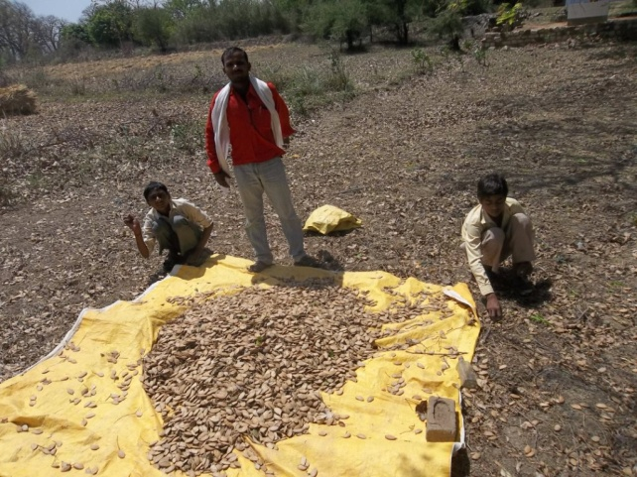
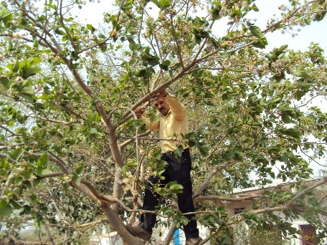
BREL
PONGAMIA: ATTRACTIVE SOURCE
BHARAT RENEWABLE ENERGY LIMITED
Sufficient Pongamia feedstock has been aggregated from forests plantation across UP
Huge potential to be explored in next season
Pongamia comes across as sustainable source of biofuel feedstock in UP
BREL is moving towards more Pongamia plantation in subsequent years

Slide 16
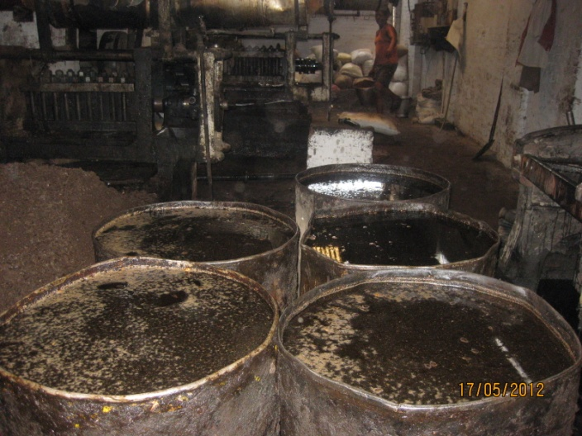
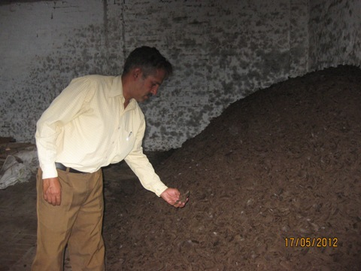
BREL
SVO PRODUCTION
BHARAT RENEWABLE ENERGY LIMITED
First lot of Jatropha SVO is produced
and sent to BPCL
for trans-esterification

Slide 17
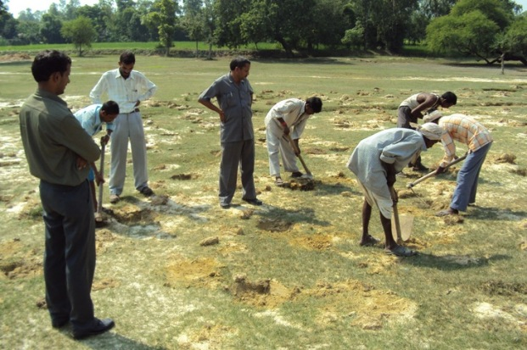
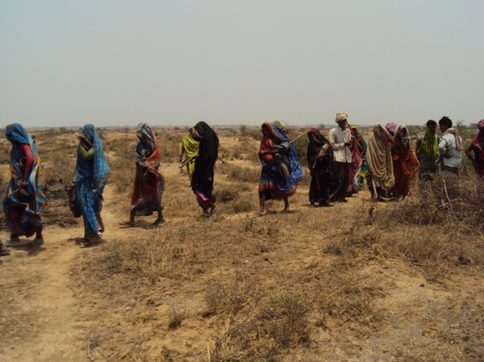
BREL
SOCIO-ECONOMIC VENTURE
BHARAT RENEWABLE ENERGY LIMITED
Employment generation, feedstock buyback from Gram Panchayats, wasteland utilization for green cover and cash crops,
Production of eco-friendly fuel reducing green house gases and emissions

Slide 18
BREL
BIODIESEL PRICING
BHARAT RENEWABLE ENERGY LIMITED
Another setback- Current biodiesel price @ Rs 32.5/ litre is much lower than that of diesel
Policy measures to justify the unreasonable gap
In the larger perspective of environment protection and limited availability of fossil fuel, bio diesel should be priced at par with diesel

Slide 19
BREL
THANKS FOR YOUR ATTENTION
BHARAT RENEWABLE ENERGY LIMITED
THANKS

