Slide 1

Business Transformation and Change Management through ERP implementation

Slide 2
Theme
Business Transformation Change Involves a great deal of fear of the unknown
Rapid economic, technological and competitive environment necessitates change in strategy, alignment, culture.
Managers have no experience of dealing this journey through the valley of death
Experienced must lead this with anticipation
ERP integrates the information systems of an organization and automates most of the functions
Risk of failure of projects
  People
  Process
  Technology

Slide 3
agenda
Change Management
  3Cs
  Role of BPR in ERP
  Why Project Fails?
  Why Resistance?
  How to Overcome Resistance
  Characteristics – Core Users / User Champions
Agenda

Slide 4
Slowness to change usually means fear to the new
Source - UNKNOWN
Change management

Slide 5

And we are in truly turbulent times
Change management

Slide 6

And TAKE, FOR EXAMPLE, A RUSSIAN COMONAUT Sergei K. Krikalev WHO SPENT 313 DAYS IN SPACE ONLY TO RETURN TO A COUNTRY THAT NO LONGER EXISTED,
Change management

Slide 7
And NOT ONLY WAS HIS COUNTRY GONE BUT HIS HOMETOWN NO LONGER HAD THE SAME NAME AS WHEN HE LEFT
Change management

Slide 8

Changing business scenario

Slide 9

The 3 forces
Viz 3C’s
Customer
Competition
Change
Change management

Slide 10

customer
The needs and demands have changed
Likely to be treated individually
Information rich hence difficult to negotiate with
Change management

Slide 11

competition
Globalization
Opening of transnational boundaries
Economic Liberalisation
Change management

Slide 12

impact
The effect of 3 forces
  Companies need to competitive
  Companies need to think and act on
    Meeting the needs and demands of customer stakeholders
    Meeting regulatory requirements
    Increasing quality of products and services
    Minimisation of costs (Optimization)
Change management

Slide 13

ROLE OF ERP
DERIVE COMPETITIVE EDGE
Transformation of Business by adopting best business practices

Slide 14
People don’t like to change
It’s commonly perceived that people in general don’t like to change, and ERP involves quite a bit of change. That is why resistance is so common on ERP projects
Change management

Slide 15
But there is a way…
The good news is that there are some key activities that can help minimize resistance to change
Change management

Slide 16
Erp implementation is packaged driven business process re-engineering

Slide 17
Role of bpr in erp
Two approaches
  Customize the ERP in accordance with the existing business processes (automation)
  Adopting the best business practices built into ERP wherever possible (business transformation)
Change management

Slide 18
Basic concept of reengineering

Slide 19
What is reengineering?
The FUNDAMENTAL Rethinking and RADICAL Redesign of business PROCESSES to achieve DRAMATIC improvement in critical contemporary measure of performance such as cost, quality, service and speed
Change management

Slide 20
Fundamental
Why Do We Do What We Do?
Why Do we Do The Way We Do?
What happens if we adopt the processes built into ERP?
How do we change our process?
Change management

Slide 21
radical
Radical redesign means Getting to the Root of the Things instead of making only superficial changes
Change management

Slide 22
dramatic
Dramatic means achieving “Quantum Leaps in Performance”
Change management

Slide 23
Benefits of reengineering
30-35% Reduction in Cost of Sales
65-70% Reduction in Cost of Quality
75-80% Reduction in Delivery Time
60-80% Reduction in Inventory
An unpredictable, but substantial increase in market share
Change management

Slide 24
What is a business process

Slide 25
Legacy applications
Islands of information
Sales
Purchase
Inventory
Payroll
Finance
Projects
Change management

Slide 26
Before reengineering
How many departments are involved ?
How Many Tasks are Performed ?
How many changes of ownership occur?
Query
Marketing
Design
Production
Costing
Change management

Slide 27

After reengineering
90 – 95% of cases – Marketing executive gives quote
No complications; No consultations
Query
Marketing
Costing
Design
Production
Change management

Slide 28
ERP connects all the critical business processes
Change management

Slide 29

departmental boundaries are broken
Change management

Slide 30
Kind of changes
Changing cultural values (Customer orientation, Ownership, Team)
Managers Change from Supervisors to Coaches (not just read traditional reports)
Executive changes from score keepers to leaders
Change management

Slide 31
Common features
Steps in processes are performed in a natural Order
Work is performed where it makes the most sense
Change management

Slide 32

Organization reduces fat
Change management

Slide 33

A set of dedicated & charged core users
Change management

Slide 34
Understanding resistance

Slide 35

Even though the best minds work together and every technical aspect is carefully scrutinized, projects can fail. Why?
Change management

Slide 36
Fortune 500 executives and chief information officers report that resistance is the primary reason why so many goods ideas fail
Change management

Slide 37

But it’s the people who can make or break the success of a project. Without their buy-in and support, projects are doomed
Change management

Slide 38
Understanding resistance
It’s not resistance itself that leads to failure; it’s the way we handle it. To respond to resistance in an effective and proactive manner, we must first understand what we are facing.
Why Resistance?
Change management

Slide 39
Understanding resistance
Listen for common fears and anxieties in the answers and strive to find out what's behind their resistance and how strong their opposition is. Knowing the intensity can help you assess how best to approach resistance - and to transform it into support for change.
Change management

Slide 40
Newton’s law of motion
The first law states
  ‘Every object in a state of uniform motion tends to remain in that state unless an external force is applied to it.’
The third one states
  ‘For every action there is an equal and opposite reaction.’
Change management

Slide 41
What newton’s law have to do with erp?
Generally, people tend to remain in a state of inertia. When an external force (for example, an ERP project) is applied on them, the most expected and immediate reaction is resistance.
Change management

Slide 42
Why resistance?
Lack of understanding about ERP
Lack of process orientation
Fear of unknown
Fear of computer
Fear of non-performance getting exposed
Transparency of data and information
Increase in accountability
Fear that importance will get reduced
Ego
Not knowing the degree of priority assigned by top management
Fear of loosing job
Change management

Slide 43
How to overcome resistance ?

Slide 44

To whom you would give control
Pilot A – 3000 Takeoff and Landing experiences
Pilot B – 200 Takeoff and Landing experiences

Slide 45
Identify change agents
Early in the project
These should be people that know the business well, embrace change, and are well-respected in the organization
This group of people, which should represent all the functional areas affected by ERP, will serve as champions of the project
They will also be key in helping other employees understand and learn the value of ERP and how it affects their jobs.
Change management

Slide 46
training
How to use the new system? (not just before “go live”)
How key business processes will be affected by ERP?
Training tools-on line help, on-going refresher training, certification etc.,
Change management

Slide 47
Employee involvement in erp movement
The more the involvement , the more the ownership
Involve people from all levels who are likely to be affected by ERP
Involvement results into increased ownership and buy-in for the ERP implementation project
Overall impact is experienced in the form of reduced resistance
Change management

Slide 48
communicate
The more the people know about why the organization is implementing ERP, how it will benefit the company, and what it means to them and their jobs, the less likely that they will resist the changes when they are implemented.
Communicate through
  Newsletter
  Bulletin board through Intranet
  Periodic workshops on ERP
  Creation of Video film about ERP
  Media coverage about ERP
Change management

Slide 49




Top 10 benefits of erp implementation
Improved Management Decision Making
Improved Financial Management
Improved Customer Service and Retention
Ease of expansion/growth and increased flexibility
More accurate transactions
Reduced cost
Increased manpower productivity
Delivery cycle time reduction
Improved inventory/asset management
Fewer physical resources/better logistics
Quality
Efficiency
Growth
Change management

Slide 50
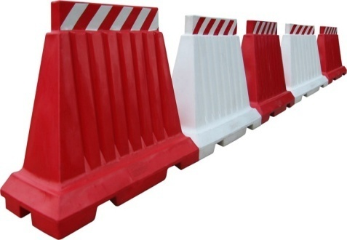



Barriers to erp implementation
ERP Barriers | Focus
Lack of Top Management Involvement & Commitment | People
Lack of Discipline | People
Lack of Change Management (Lack of User Acceptance) | People
Inadequate Training | People
Poor Reporting Procedures about status & progress | People
Customization chosen over changing the business practice built in ERP | Process
Lack of Dedicated Team | People
Poor Prioritisation of Resources (H/w, S/w, connectivity, project infrastructure etc.,) | Technology
Upgrades Poorly Performed (Database, PCs, servers, ERP) | Technology
People
Process
Technology
Change management

Slide 51
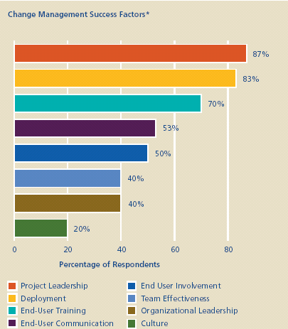
Change management

Slide 52
Characteristics – effective core users
Senior enough to take decision
Possess excellent knowledge for processes in his/her business area
Ability to visualize future requirements based on organization plan and growth
Should be a good listener
Ability to communicate among end users
Able to work in a team
Should be a good teacher
Change management

Slide 53
Seek excellence & success will follow

Slide 54
Any questions?

Slide 55
r. BALASUBRAMANIAN
Practice head (utility & telecom)
+91 9810848948
r.balasubramanian@ifsworld.com

