Slide 1
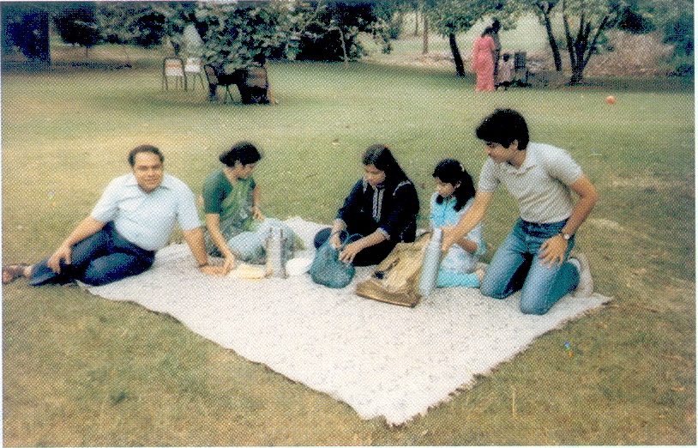
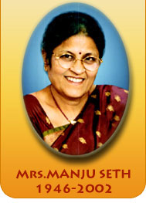
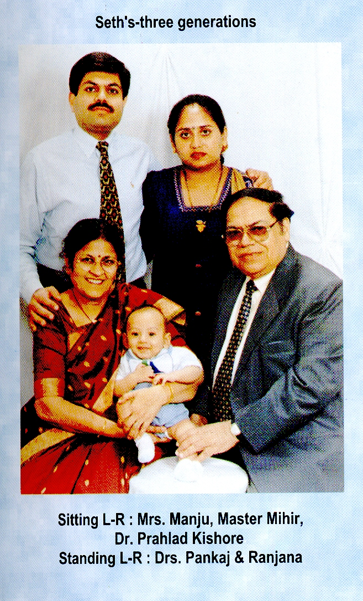
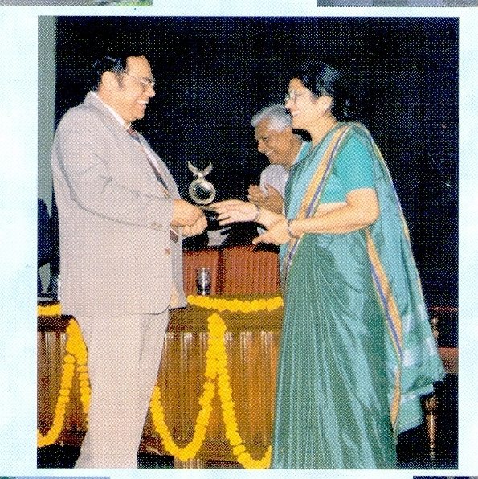

Slide 2
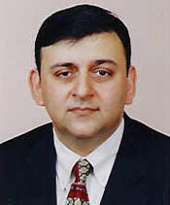
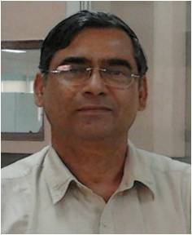
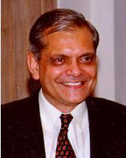
Previous Manju Seth Foundation Lecturers
Dr. Sandeep Kumar
Director, AIIMS
Bhopal
Dr. Sanjeev Misra
Director, AIIMS
Jodhpur
Dr. SC Tewari
Prof. & Head
Deptt. of Geriatric Mental Health,
KGMU, Lucknow
Dr. SPS Gaur
Head
Pharmacology Division
CSIR-CDRI, Lucknow
Dr. UK Misra
Prof. & Head
Deptt. Of Neurology
SGPGIMS, Lucknow

Slide 3
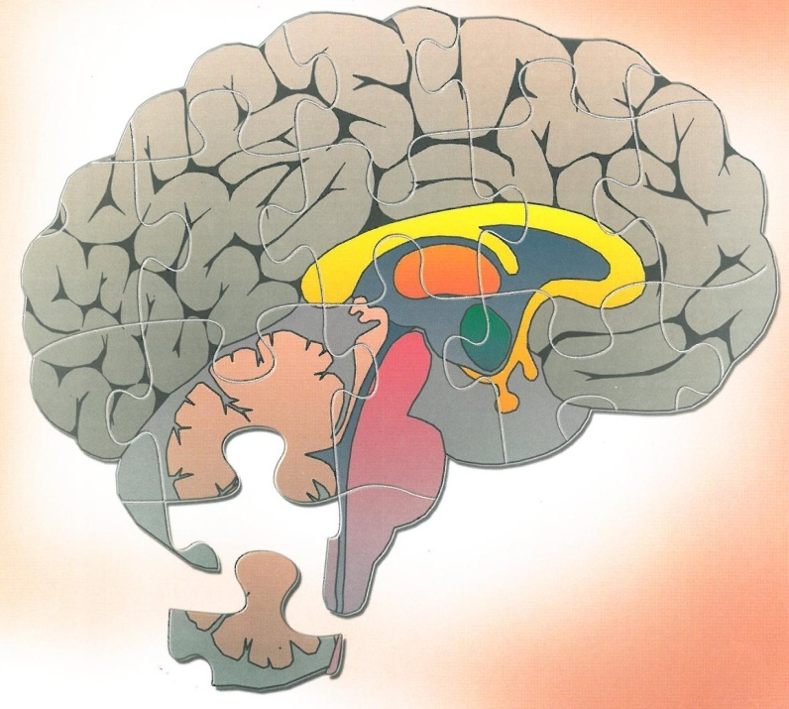
“…And men should know that from nothing else but the brain came joys, delights, laughter and jests and sorrows, grief's, despondency and lamentations and by this, in an especial manner, we acquire wisdom and knowledge, and see and hear and know what are foul and what are fair, what sweet and what unsavory….”
The Hippocratic Writings, 420 BC
Hippocrates, The Father of Medicine

Slide 4
Global burden of neurological and mental disorders (WHO 2014)
The last three decades have witnessed an explosion of
interest in the field of neurosciences
90% of all we know about neuroscience has accumulated
during this period
Neurological disorders are one of the greatest threats to public
health

Slide 5
Global burden of neurological and mental disorders (WHO 2014)
The last three decades have witnessed an explosion of
interest in the field of neurosciences
90% of all we know about neuroscience has accumulated
during this period
Neurological disorders are one of the greatest threats to public
health
Non-contagious neurological disorders comprised 3% of global
burden of disease in 2010
This number is expected to grow as life expectancy
increases
Brain disorders account for only 10& of all deaths, but in
developing countries they are responsible for at least 27%
disease burden expressed as, DALY

Slide 6
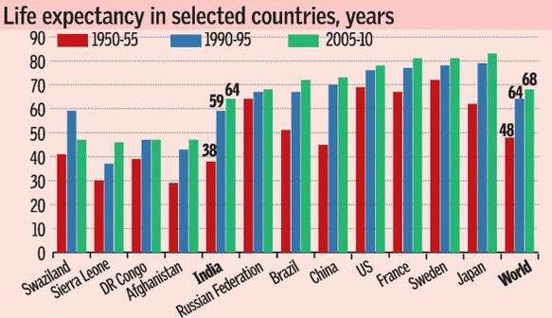
Average life expectancy in India

Slide 7
Global burden of neurological and mental disorders (WHO 2014)
The last three decades have witnessed an explosion of
interest in the field of neurosciences
90% of all we know about neuroscience has accumulated
during this period
Neurological disorders are one of the greatest threats to public
health
Non-contagious neurological disorders comprised 3% of global
burden of disease in 2010
This number is expected to grow as life expectancy
increases
Brain disorders account for only 10& of all deaths, but in
developing countries they are responsible for at least 27%
disease burden expressed as, DALY

Slide 8
Healthy Ageing: Healthy Brain
Sixth Manju Seth Foundation Lecture
Dr. Rakesh Shukla
Department of Neurology
King George’s Medical University
Lucknow

Slide 9
Healthy Ageing: Healthy Brain
Sixth Manju Seth Foundation Lecture
Dr. Rakesh Shukla
Department of Neurology
King George’s Medical University
Lucknow

Slide 10
WHO definition of health

Slide 11
What is old age
WHO definition of health
60 years- senior citizen
In Biblical terms old age is said to be three scores and ten ie. 70
years
Old age is subdivided into three categories
- Young old 65-75 years
- Old 75-85years
- Oldest old >85 years

Slide 12
William Shakespeare
1564-1616
Old age is a time of second childishness and mere oblivion. When the brain function becomes progressively impaired, leading to defects in memory, reasoning and judgment and even the most basic of activities of daily living, such as bathing and eating become difficult to perform

Slide 13
Portrayal of old age
Feeble, idle, obstinate, given to reminiscing and having
tremulous hands, quivering voice, stooped posture and slow
shuffling steps
Opinionated, repetitive, self centered, rigid and conservative in
their thinking
Mouthing movements, stereotypical grimacing, protrusion of
the tongue, side to side or to and fro tremors of the head, odd
vocalizations such as sniffing, snorting, and bleating

Slide 14
Frequency of neurologic signs
in uncomplicated aging (in percent)
Age (years)
Sign | 65-69 | 70-74 | 75-79 | >80
Glabellar sign (inability to inhibit blink) | 10 | 15 | 27 | 37
Snout reflex | 3 | 8 | 7 | 26
Limited upgaze | 6 | 15 | 27 | 29
Abnormal visual tracking | 8 | 15 | 26 | 34
Paratonic rigidity | 8 | 18 | 22 | 32
Unable to recall 3 words | 6 | 10 | 12 | 21
Unable to spell world backward | 10 | 12 | 18 | 21

Slide 15
Neurological and cognitive impairments detected in older people without disease
Advanced age is associated with abnormalities on neurological
and cognitive examination
When healthy older adults are studied such changes are not
inevitable
They are associated with adverse outcome including functional
decline and death, and so should not be considered benign
Cognitive change in healthy older adults is minimal
Abnormal neurological signs in older adults should be
investigated and treated in a similar way to those found in
younger adults.
Woodford HJ, George J. Postgrad Med J 2011;87:199-206.

Slide 16
Neurobiol Ageing 2008 Aug;29(8):1127-32. doi: 10.1016/j.neurobiolaging.2008.04.010. Epub 2008 Jun 4.
No disease in the brain of a 115-year-old woman.
den Dunnen WF¹, Brouwer WH, Biijlard E, et al.
Abstract
Are there limits to the duration of high quality of life? Are there limits to healthy life for a human brain? We have had the opportunity to evaluate the performance of a 112-113-year-old woman and perform full pathological examination of her body immediately after death at the age of 115. The psychological tests revealed that her general performance was above average of healthy adults of 60-75 years. The pathological observations revealed almost no atherosclerotic changes throughout the body. In the brain almost no beta-amyloid plaques or vascular changes were found and only slight accumulation of hyperphosphorylated tau protein with a Braak-stage 2. Counts of the number of locus coeruleus neurons corresponded with the number of neurons found in the brains of healthy people of 60-80 years old. Our observations indicate that the limits of human cognitive function extends far beyond the range that is currently enjoyed by most individuals and that brain disease, even in supercentanarians, is not inevitable.

Slide 17
Types of memory
Types of memory function | Assessment
Short-term memory | *Repeating back a short string of digits
Long-term memory *Episodic memory *Semantic memory *Procedural memory | *Remembering three words after a few minutes *Recalling facts such as “What color is grass”? *Being able to perform motor skills such as driving car

Slide 18
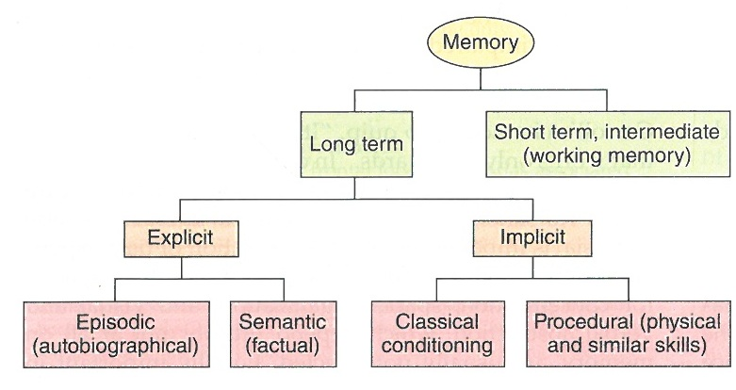
Types of memory
Types of memory function | Assessment
Short-term memory | *Repeating back a short string of digits
Long-term memory *Episodic memory *Semantic memory *Procedural memory | *Remembering three words after a few minutes *Recalling facts such as “What color is grass”? *Being able to perform motor skills such as driving car

Slide 19
Effect of age on memory
Decline in memory storage (i.e. the ability to learn new information)
Decline in the speed of mental processing
Conscious recall (Declarative memory) is more often impaired than is motor memory for previously learned skills, such as playing the piano (Procedural memory)

Slide 20
Effect of age on memory
Decline in memory storage (i.e. the ability to learn new information)
Decline in the speed of mental processing
Conscious recall (Declarative memory) is more often impaired than is motor memory for previously learned skills, such as playing the piano (Procedural memory)
Recall of context-specific information (Episodic memory) is more affected than the recall of general information (Semantic memory)
Retrieval is more impaired than recognition.
Immediate memory span and long-term memory are preserved

Slide 21
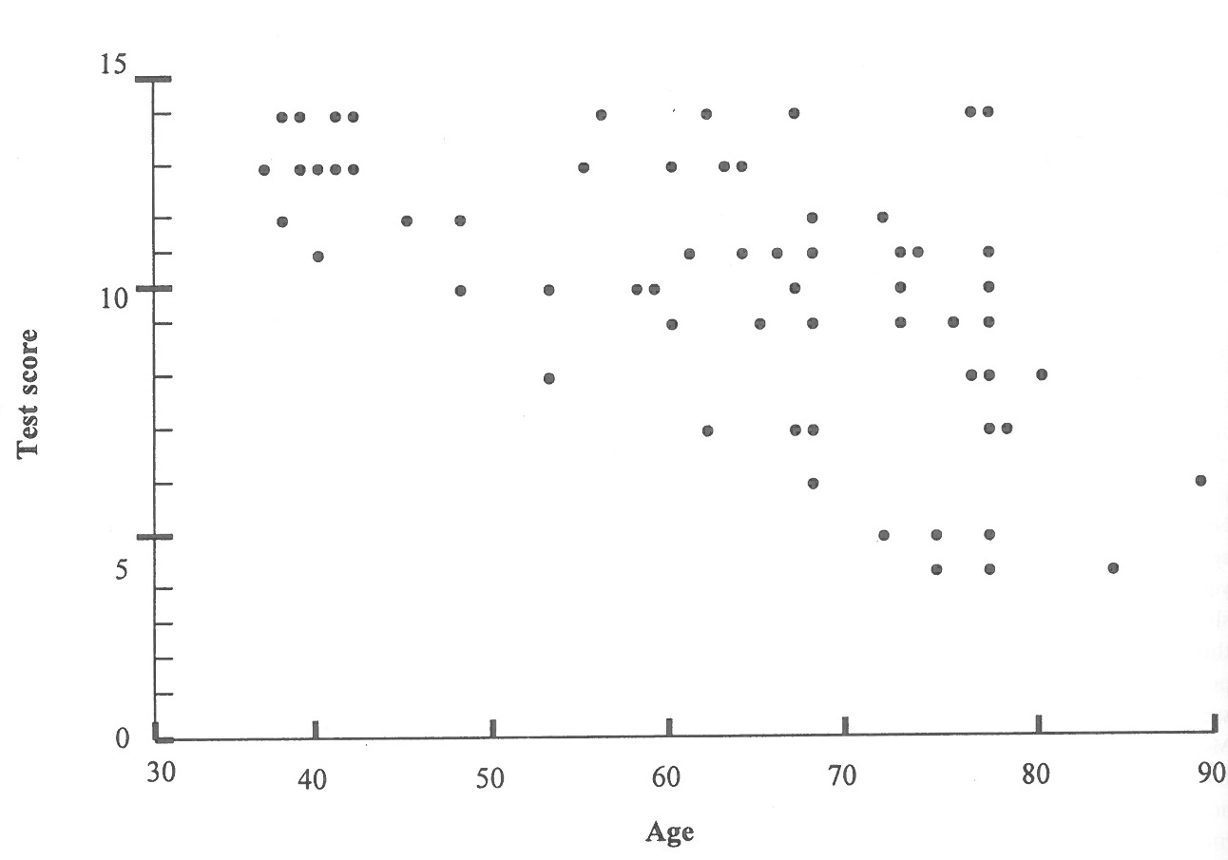
Inter-individual differences and ageing

Slide 22
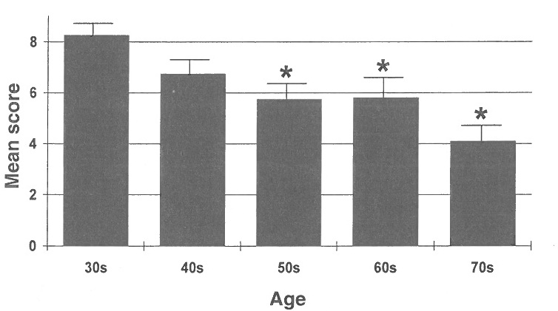
Delayed recall performance of healthy subjects (30-80 years)

Slide 23
When does age-related cognitive decline begin?
“Cognitive decline may begin after midlife, but most often occurs
at higher ages (70 or higher)”. Aartsen, et al 2002
“… relatively little decline in performance occurs until people
are about 50 years old”. Albert & Heaton, 1988
“… Cognitive abilities generally remain stable throughout adult
life until around age 60. Plassman et al, 1995
Salthouse TA. Neurobiol Aging 2009;30:507-14.

Slide 24
When does age-related cognitive decline begin?
“Cognitive decline may begin after midlife, but most often occurs
at higher ages (70 or higher)”. Aartsen, et al 2002
“… relatively little decline in performance occurs until people
are about 50 years old”. Albert & Heaton, 1988
“… Cognitive abilities generally remain stable throughout adult
life until around age 60. Plassman et al, 1995
“…no or little drop in performance before age 55….”. Ronnlund,
et al 2005
“…most abilities tend to peak in early mid life, plateau until the
late fifties or sixties, and then show decline, initially at a slow
pace, but accelerating as the late seventies are reached.”
Schaie, 1989
Some aspects of age related cognitive decline begin in healthy
educated adults in their 20s and 30s
Salthouse TA. Neurobiol Aging 2009;30:507-14.

Slide 25
Cognitive states of the elderly
Normal Cognitive Ageing
Supernormal (5%) Age Consistent
Memory Decline
No complaints Some Impairment
Abnormal Cognitive Ageing
Mild Cognitive Impairment
No change Deterioration
with time with time
Stable Mild Dementia
Impairment
Chertkow H et al., Can J Neurol Sci 2001;28(Suppl 1):S28-S41.

Slide 26
Successful mental health aging
n=601
Reaching age 80 years with MMSE score ≥ 24 and GDS-15 score ≤ 5
3 out of 4 underwent successful mental health ageing
Lifestyle modification (increasing physical activity and reducing saturated fat in diet) and education are the factors associated with successful mental health aging
Almeida OP, Noramp P, Haankey G, Jamazik K, Flicker I. Am J Geriatr Psychiatry. 2006;14(1):27-35.

Slide 27
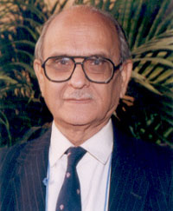
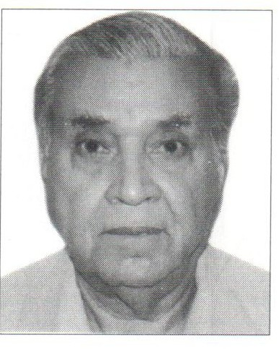
Some individuals with successful mental ageing

Slide 28
Some individuals with successful mental ageing
Dr. Nitya Anand
1925
Dr. NH Wadia
1925
Dr. PN Tandon
1928
Dr. KB Bhatia
1928
Dr. G Arjundas
1928
Dr. Abdul Halim
1929

Slide 29
Life style choices for brain health
Adequate sleep
Healthy diet
Exercise
Learning new things
Staying socially connected
Reducing other cardio vascular risk factors

Slide 30
Methods to keep your brain young
Diet
Keep your calories in check. Reducing calorie intake helps in
lowering risk of mental decline
Eat the right food. Reduce fatty foods, junk foods. Increase
fruits and vegetables in diet.? Alcohol. Avoid tobacco
Remember your Bs- 3B Vitamins, folic acid, B6 & B12 lowers
homocysteine levels leading to decrease risk of dementia
Contd…

Slide 31
Diet contd…
Dietary fatty acids may reduce risk of cognitive decline
Fatty fish and marine omega-3 PUFA consumption was associated with a reduced risk and intake of cholesterol and saturated fat with an increased risk of impairment of cognitive function
Mechanism is by anti-inflammatory effect, inhibiting synthesis of cytokines and mitogens and effect on membrane fluidity neurotransmission and synaptic plasticity

Slide 32
Mediterranean diet improves cognition: the PREDIMED-NAVARRA randomised trial

Slide 33
Mediterranean diet improves cognition: the PREDIMED-NAVARRA randomised trial
Multicentre randomised primary prevention trial
n-=522 participants at high vascular risk (44.6% men, age
74.6±5.7 years)
Two Med Diets (supplemented with either extra-virgin olive oil or
mixed nuts) versus a low fat control diet

Slide 34
Mediterranean diet improves cognition: the PREDIMED-NAVARRA randomised trial
Multicentre randomised primary prevention trial
n-=522 participants at high vascular risk (44.6% men, age
74.6±5.7 years)
Two Med Diets (supplemented with either extra-virgin olive oil or
mixed nuts) versus a low fat control diet
MMSE and CDT were done at baseline and after 6.5 years of
nutritional intervention
Med Diet + EV00 and Med Diet + nuts showed higher mean
MMSE and CD scores with significant differences versus controls
An intervention with Med Diets enhanced with either EV00 or
nuts appears to improve cognition compared with a low fat diet
Martinez-Lapiscina EH, Clavero P, Toledo E et al. J Neurol Neurosurg Psychiartry 2013;84:1318-25.

Slide 36
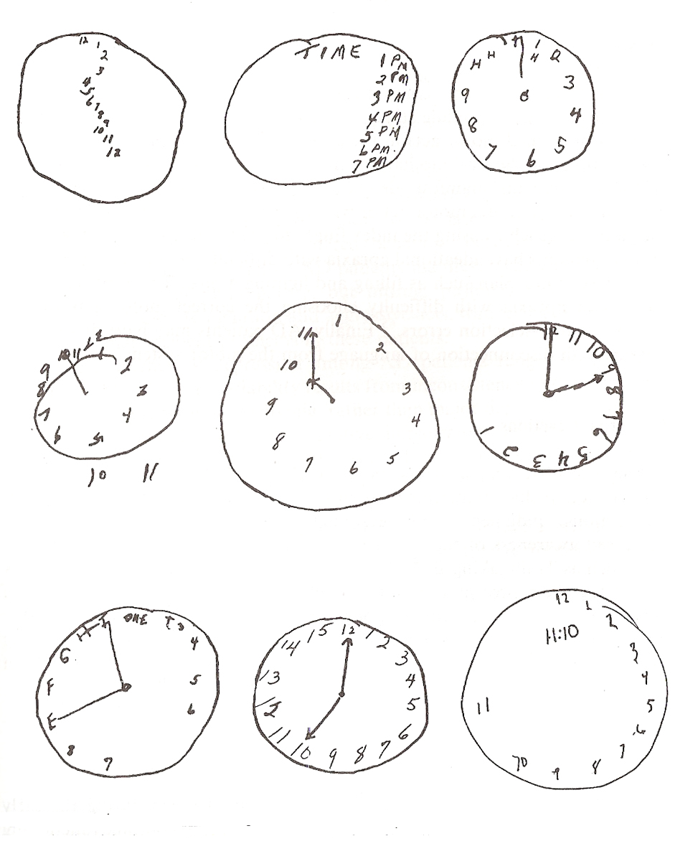
Clock drawing test
Task: Draw face of clock with numbers and indicate
hands at “ten minutes after eleven”

Slide 37
Mediterranean diet improves cognition: the PREDIMED-NAVARRA randomised trial
Multicentre randomised primary prevention trial
n-=522 participants at high vascular risk (44.6% men, age
74.6±5.7 years)
Two Med Diets (supplemented with either extra-virgin olive oil or
mixed nuts) versus a low fat control diet
MMSE and CDT were done at baseline and after 6.5 years of
nutritional intervention
Med Diet + EV00 and Med Diet + nuts showed higher mean
MMSE and CD scores with significant differences versus controls
An intervention with Med Diets enhanced with either EV00 or
nuts appears to improve cognition compared with a low fat diet
Martinez-Lapiscina EH, Clavero P, Toledo E et al. J Neurol Neurosurg Psychiartry 2013;84:1318-25.

Slide 38
Cardiac risk factors
Hypertension
Most robust link between hypertension and cognitive decline. Antihypertensive treatment for four years leads to 55% reduction in dementia incidence
Body Weight
Cholesterol
Smoking
Alcohol Intake
Forette F, Seux ML, Staessen JA, et al Arch Intern Med. 2002;162:2046-2052.

Slide 39
Hypertension and dementia
Risk factor for cognitive impairment
Increased risk of strokes which may produce dementia (Multi-Infarct or Vascular Dementia)
Associated with periventricular white matter disease, which is independently associated with cognitive deficits
50% reduction in the incidence of dementia in treated patients with isolated systolic hypertension
Accelerates atherosclerosis which is another risk factor for Alzheimer’s disease and vascular dementia

Slide 40
Obesity, type 2 diabetes and cognitive decline
Disturbances in peripheral glucose regulation are associated with cognitive impairment and depressed mood
Underlying mediators and mechanism are insulin, glucose, neurotropic factors, glucocorticoids, inflammatory agents and reactive oxygen species
Life style modification (increasing physical fitness and moderate/ changing food intake) will have beneficial effect
Hendrickx H, McEwen BS, Ouberaa F. Neurobiol Aging. 2005;26(Suppl 1):1-5.

Slide 41
Methods to keep your brain young
Physical Exercise
Risk of any dementia 52% less in active cohort
Increasing levels of activity was inversely correlated with risk of
cognitive impairment
Physical activity of 20-30 minutes twice a week enough to cause
breathlessness and sweating
People who exercise tend to live healthier lifestyles such as
drinking less alcohol and refraining from smoking
Contd…

Slide 42
Methods to keep your brain young
Exercise increases the tiny blood vessels to the areas of brain responsible for thought
Development of new nerve cells and increases synapses
Affects several gene transcript and neurotropic factors promote brain plasticity and reduces amyloid plaque burden

Slide 43
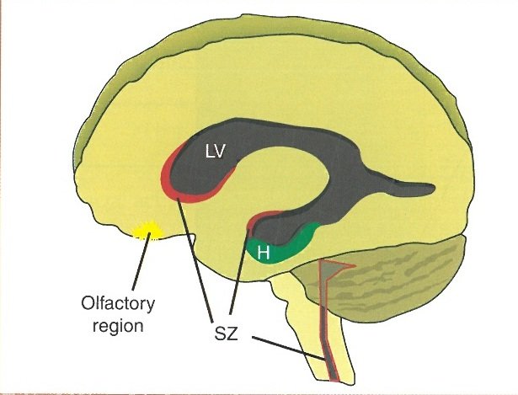
Methods to keep your brain young
Exercise increases the tiny blood vessels to the areas of brain responsible for thought
Development of new nerve cells and increases synapses
Affects several gene transcript and neurotropic factors promote brain plasticity and reduces amyloid plaque burden
Neural stem cell in adult human brain

Slide 44
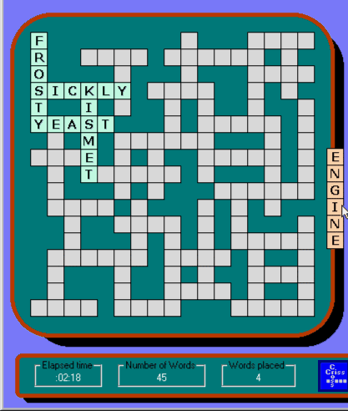
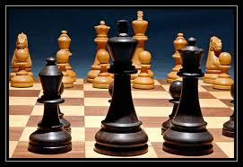
Methods to keep your brain young
Mental stimulation
Brainy activities stimulate new connection between nerve
cells, developing neuronal plasticity and building a
functional synapse. Examples – Mental gymnastics such as
word puzzle and math problems, drawing, painting and
other crafts.
The Harvard Medical School Family Health Guide.

Slide 45
Methods to keep your brain young
Miscellaneous
Care for your emotions
Don’t get anxious, depressed, sleep deprived or exhausted. Keep good mental health and restful sleep.
Protect your head
Avoid moderate to severe head injuries in early life.
Build social networks
Get involved in social activities and build strong social ties.

Slide 46
Why does lack of sleep impair brain function?
Natural sleep or anaesthesia are associated with a 60%
increase in the interstitial space
It leads to striking increase in convective exchange of
cerebrospinal fluid with interstitial fluid
This results in efficient connvective clearance of β-amyloid and
other compounds
Restorative function of sleep may be a consequence of
enhanced removal of potentially neurotoxic waste products
that accumulate in the awake state.
Xie L, et al., Sleep drives metabolic clearance from the adult brain.
Science 2013;342(6156):doi:10.1126/science. 1241224.

Slide 47
Excessive daytime sleepiness is predictive of cognitive decline in elderly
n=4894 patients with dementia
8 year longitudinal follow up study
4 point decline in MMSE score
EDS independent ly increased the risk of cognitive decline (OR
1.26, 95%/CI 1.2-1.56)
EDS may be an early bio-marker of cognitive decline
Jaussent I, Bouyer J, Ancelin ML, et al. Sleep 2012;35:1201-7.

Slide 49
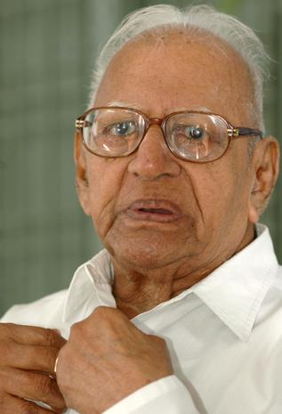
Jeevem Sharadah Shatam
Pashyem Sharadah Shatam
Shrinuyam Sharadah Shatam
Prabaram Sharadah Shatam
Bhooyashah Sharadah Shatam
Justice VR Krishna Iyer
15 Nov 1915 - 4 Dec 2014

Slide 50
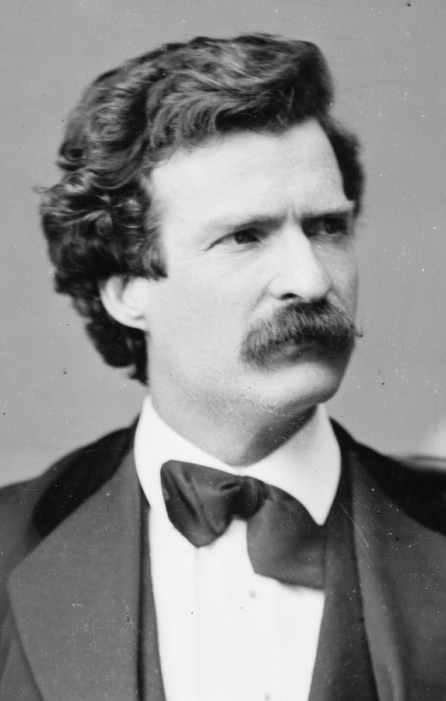
Age is an issue of mind
over matter.
If you don’t mind
it doesn’t matter.
Mark Twain
1835-1910

Slide 51
Age is an issue of mind
over matter.
If you don’t mind
it doesn’t matter.
Mark Twain
1835-1910

