Slide 1
ALTERNATIVE THERAPIES
MAGNET THERAPY
BACH FLOWER REMEDY
E.F.T.
BY
DR. RUKMINI SAWHNEY
M.D.(MED)

Slide 2
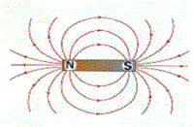
MAGNET THERAPY
A magnetic field is the environment around a magnet in which magnetic forces act. Magnetic field lines represent the area around a magnet: magnetic field lines flow from the north pole to the south pole.

Slide 3
HOW DOES MAGNET THERAPY WORK?
Your blood is a living tissue that circulates around your whole body via a network of arteries, veins and capillaries, it carries nutrients, oxygen, hormones, antibodies, heat, electrolytes and vitamins to the body’s tissues. Blood contains red blood cells, white blood cells, platelets, plasma, electrolytes, hormones, minerals and iron.

Slide 4
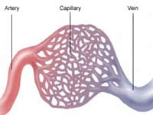
The blood is transported from the heart to the lungs where it picks up oxygen and then transports it to all the organs and tissues. Every part of the body depends on blood to provide the necessary oxygen and nutrients it needs to survive.

Slide 5
How Do Magnetic Fields Affect Blood Flow?
Magnets are composed of metal alloys such as iron, nickel or cobalt. They will attract many different types of metallic particles. The blood contains iron and when therapeutic magnets are placed on the skin the magnetic field penetrates through the skin and into the surrounding tissues and blood stream. The iron in the blood is attracted to the magnetic field, this causes movement within the blood stream and the increased activity causes the blood flow to improve.

Slide 6
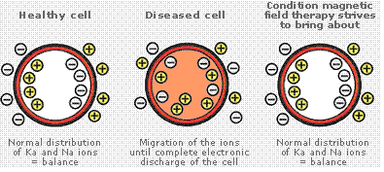
Ionic distribution in healthy cell, diseased cell, and magnetic influenced cells

Slide 7
The Inflammatory Process
Inflammation is the body’s reaction to invasion by an infectious agent, antigen or even just physical, chemical or traumatic damage. When damage occurs the body’s automatic defense system starts the inflammatory process within seconds. Blood flow is firstly increased at the point of injury, the blood vessels widen (vasodilator) to allow oxygen, clotting agents (platelets) and white blood cells to penetrate the damaged tissues. Over a period of hours the concentration of white blood cells increases at the injury site (white blood cells fight infection).

Slide 8
How Do Magnetic Fields Influence Inflammation?
When static magnets are placed over an area of inflammation, the magnetic field penetrates through the skin and deep into the tissues and blood stream. Damaged cells will react to the presence of a magnetic field by realigning their ions into the correct position. This begins the process of eliminating the excess fluid from with in the cell. Cell damage will stop and healing of the cells will begin over a period of days.

Slide 9
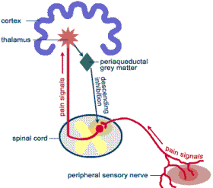

Slide 10
Pain killers only last for a short period of Time. Depending on the type of pain killer and where they interrupt the pain pathway and the strength of the drug, they can last from 4-12 hours. Magnets do not block the pain signal. They work on the cause of the pain, which is why static magnets have to be placed as close to the point of pain possible. Results can take any where from 2 days – 6 weeks depending on the condition and the severity of the injury.

Slide 11
MAGNET THERAPY FOR COMMON DISEASE
1.Abscess 11 Coryza
2.acne 12. Corn
3.Asthma 13. Cuts, injury
4.Arthritis 14. Diabetes
5.Backache 15. Earache
6.Insect bite 16. Eczema
7.Bronchitis 17. Epilepsy
8.Colic 18. Headache
9.Colitis 19. Insomnia
10.Hyperacidity 20.Migrain
21.Leucorhea 31.. Obesity
22.Jaundice 32. Piles
23.Prostate En.33. allergy
24.Hypertension 34.U.T.I.
25.Cervical spondylitis
26.Frozen shoulder
27.Fracture 35.Dysmenorh
28.Slipped disc 36.toothach
29.Varicose veins37.Psoraisis
30.Sore throat 38.constipati

Slide 12
5 METHODS OF APPLICATION OF MAGNETS
pole of magnet where to be applied
1. North pole right hand
south pole left hand
North pole right hand
south pole left foot
North pole left hand
south pole left foot
North pole right hand
south pole right foot
North pole right foot
south pole left foot

Slide 13
Magnetised water
Water & other liquids can be magnetised by keeping it in any container over magnets for 6 hours.
Magnetised water reduces acidity, regularizes bowel movement ,improves digestion.
It reduces B.P., clears clogged arteries ,helps in asthma ,bronchitis, cold & al types of fever.
Used for washing sore eyes, wounds, eczema for quick healing.

Slide 14
PRECAUTIONS DURING MAGNET THERAPY
Stomach should not be full.
No cold thing to be eaten or drunk 1 hour after.
Sensitive organs like brain ,heart & eyes should not be treated by strong magnets.
Pregnant women should be treated with weak magnets.
Wrist watch ,mobiles, metallic things should be removed.
The patient should preferably sit or lie down in north –south direction on a wooden chair or bed.

Slide 15
BACH FLOWER REMEDY
Dr. Edward Bach of England has discovered 38 medicines from flowers corresponding to 38 possible moods of man.
These flower essences are basically spring water blessed with the life force of the flowers transferred to it through the energy of the sun.
Dr.Bach considered illness to be a reflection of disharmony between the soul & the conscious personality.

Slide 16
BASIS OF USING BACH FLOWER REMEDIES
Disharmony of mind & emotions is the breeding ground for all the illnesses. A person feels ill-at-ease after his emotions are disturbed.
Not only do these essences neutralize the negative emotional state, they flood the body with positive healing vibrations.
Bach flower remedies remove conflict between the intention of the person’s soul and the action of his conscious body.

Slide 17
THE 38 NAMES
1.Agrimony 11.Elm
2.Aspen 12.Gentian
3.Beech 13.Gorse
4.Centaury 14.Heather
5.Cerato 15.Holly
6.Cherry plum16.Honey suc
7.Chestnut bud 17.Horn bea
8.Chicory 18.Impatiens
9.Clematis 19.Larch
10.Crab apple 20.Mimulus
21.Mustard 31. Vervain
22.Oak 32. Vine
23.Olive 33. Walnut
24.Pine 34.Water violet
25.Red chestnut 35.White ch
26.Rock rose 36.Wild oat
27.Rock water 37.Wild rose
28.Scleranthus 38.Willow
29.Star of Bethlehem
30.Sweet chestnut
39.RESCUE REMEDY

Slide 18
DISEASE-ITS SEVEN BASIC CAUSES
Dr.Bach had classified seven types of personalities who had a particular way of reacting to mental/emotional imbalance, which are as listed below
1.Fear ; 2.uncertainity ; 3.insufficiant interest in present ;4. loneliness ; 5.oversensitive to influences and ideas ;6. despondency & despair ; 7.over care for welfare for others.

Slide 19
FEAR& IT’S 5 FORMS
MIMULUS—FEAR OF KNOWN CAUSE
ASPEN-VAGUE FEARS of UNKNOWN ORIGIN
ROCK ROSE-TERROR,PANIC,EXTREME FRIGHT
CHERRY PLUM-fear of losing control of mind
Red chestnut-apprehensions, anxiety for others

Slide 20
INDECISIVENESS & ITS 6 FORMS
1.Cerato---self distrust, foolish
2.Gentian—doubt, depression, discouragement
3.Gorse---hopelessness, despair
4.Hornbeam—weariness before starting work
5.Scleranthus—uncertainity,indecision
6.Wild oat—dissatisfaction with profession

Slide 21
Disinterest in the present-its 7 forms
1.Chestnut bud-lack of observation, repeats mistakes
2.Clematis –inattention, dreaminess
3.Honeysuckle –homesickness, living in the memory of the past
4.Mustard –black depression, sudden and unknown cause
5.Olive –complete exhaustion, physical & mental
6.White chestnut-persistent unwanted thoughts
7.Wild rose-apathy, resignation

Slide 22
LONELINESS—its 3 forms
1.Heather –over talkative, self centered, self concerned
2.impations—impatiences,quick temper, mental tension
3.Water violet—pride, aloofness

Slide 23
DESPONDENCY & ITS 8 FORMS
1.Crab apple-the cleanser, over emphasis on trivial details
2.Elm –temporary feeling of inadequacy
3.Larch –lack of self confidence
4.Oak –continuous effort despite setbacks, believes nothing is impossible
5.Pine –self reproach, guilt feeling
6.Star of Bethlehem-after effects of shock mental & physical
7.Sweet chestnut-extreme mental anguish, hopelessness
8.Willow –resentment, bitterness

Slide 24
OVER CARE FOR OTHERS & ITS 5 FORMS
1.Beech-enforces discipline under all circumstances
2.chicory-possesiveness,self love
3.Rock water-self repression, self denial
4.vervain-over enthusiasm,tension,stress
5.vine-ambitious,dominating,ruthless

Slide 25
INFLUENCED EASILY-ITS 4 FORMS
1.Agrimony-mental torture concealed from others
2.Centaury –weak willed, weakness after illness
3.Holly –hatred, envy, jealousy, suspicion
4.Walnut –link breaker, liable to be swayed by better ideas

Slide 26
THE ETERNAL TRUTH
’Let not the simplicity of this method deter you from its use, for you will find the further your researches advance, the greater you will realize the simplicity of all creation.’’
“Take no notice of the disease; think only of the outlook of life of one in distress.”
“Final and complete healing will come from within, from the soul itself, which by HIS BENEFICENCE radiates harmony throughout the personality when allowed to do so.”
EDWARD BACH

Slide 27
E.F.T. EMOTIONAL FREEDOM TECHNIQUE
BY
Dr. RUKMINI SAWHNEY
M.D. ( Medicine )

Slide 28
EFT or emotional freedom technique has been invented and introduced by a Stanford engineer Gary Craig. It is a universal healing tool, which is amazingly simple and profoundly effective technique to free our mind from the life long baggage of negative emotions.

Slide 29
It is not only gives emotional freedom but also heals physical problems be it acute or chronic and it is a miracle method for healing pain. Hence this technique is also called psychological acupressure. The process involves tapping with fingers on different meridian points in a sequence with a statement related to disease / problem to be solved.

Slide 30
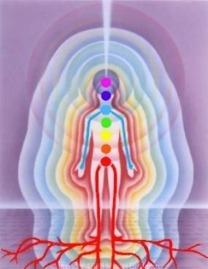
Our Energy Body

Slide 31
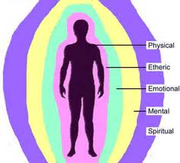
ENERGY BODY

Slide 32
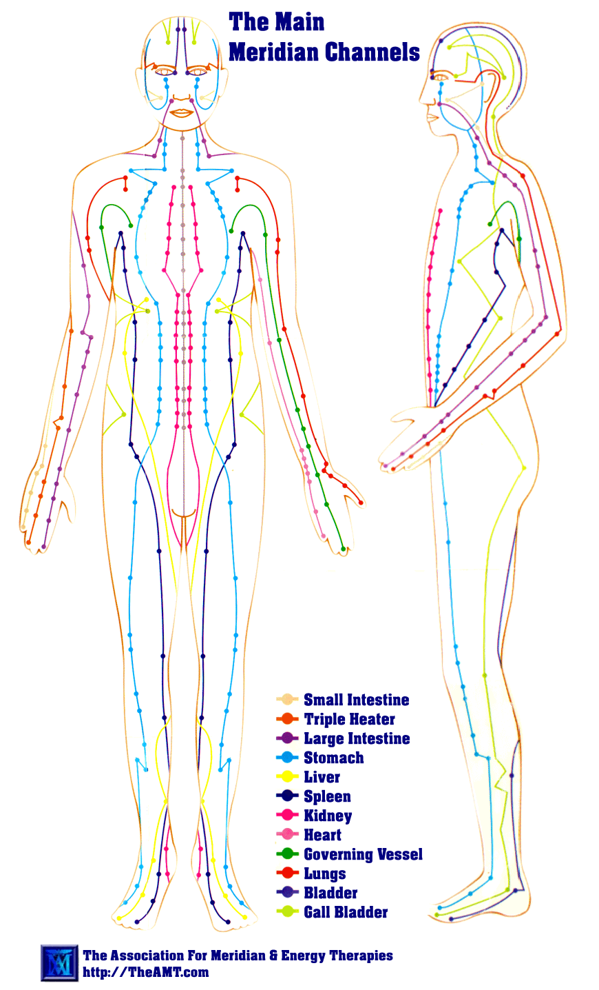
Meridian channels

Slide 33
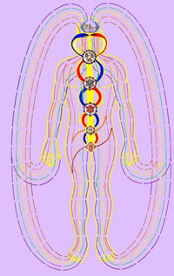
ENERGY FLOW OF AURA & CHAKRA

Slide 34
PRINCIPLE OF E.F.T.
THE DISCOVERY STATEMENT :- The cause of all negative emotions is the disruption in body’s energy system .
Tapping on different meridian points corrects the disruption of energy channels & eliminates negative emotions.

Slide 35
How a negative emotion is caused
Step 1 step 2 step 3
Distressing A disruption in Negative memory - the body’s Emotion
energy system

Slide 36
Emotional Freedom Techniques
The Basic Recipe
1. Where in your body do you feel the emotional issue most strongly?
2. Determine the distress level in that place in your body on a scale of 0 to 10, where 10 is
maximum intensity and 0 is no intensity:
10, 9, 8, 7, 6, 5, 4, 3, 2, 1, 0

Slide 37
3. The Setup: Repeat this statement three times, while continuously tapping the Karate Chop
point on the side of the hand (large dot on hand diagram below)
"Even though I have _______(name the problem), I deeply and completely accept myself."
4. The Tapping Sequence: Tap about 7 times on each of the energy points in these 2
diagrams, while repeating a brief phrase that reminds you of the problem.
.

Slide 38
TAPPING POINTS
EB= EYE BROW
SE= SIDE EYE
UE= UNDER EYE
UN = UNDER NOSE
CH= CHIN
CB =COLLAR BONE
UA= UNDER ARM
BN= BELOW NIPPLE
Th= THUMB
IF = INDEX FINGER
MF= MIDDLE FINGER
BF= BABY FINGER
KC = KARATE CHOP
WRIST POINT
TOP OF HEAD

Slide 39
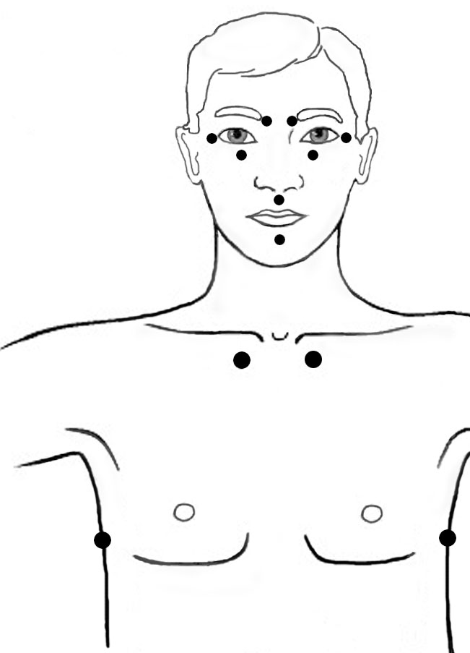
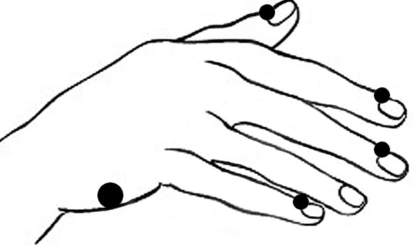

Slide 40
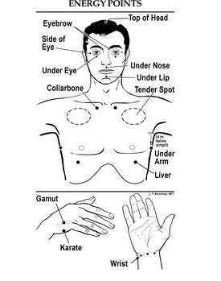

Slide 41
USES OF E.F.T.
EFT is used to heal a variety of mental and physical problems. The list is long, some problems are :
Negative emotions like anger, frustration, jealousy, depression, lack of self confidence, fear apathy, Anxiety, stubbornness, hatred, grief, guilt, insomnia, suicidal tendencies, etc.
Physical problems like aches and pains, arthritis, accidental injuries, multiple sclerosis, Parkinsonism, neuralgia.

Slide 42
USES OF E.F.T.
Allergy, insect bite, eczema.
Menstrual problem, urinary problems, obesity, hormonal disbalance.
It is used to clear all the blocks to health, wealth,, prosperity, it is to used to enhance ones creativity, improve sports performance, remove fear of public speaking and in many ways for all round personal development.

Slide 43
E.F.T. FOR FEAR
When a fear thought comes up, simply say thanks for sharing, thank you for protecting me. Do not give it power. Don't run from it. Whatever comes up, it is very important to acknowledge it, when you hear them you can even write them down.

Slide 44
Once you have written the fear though down, you can turn it around to a positive affirmation and tap it in with EFT. You can say even though I have this fear (name the fear) I deeply love and accept myself and I fully appreciate that it is only trying to help me.

Slide 45
Then do an affirmation for what you really want, which is typically the positive present tense opposite of the fear, or whatever positive outcome you would desire instead of the fear.

Slide 46
Avoid denying the fear. You always want to acknowledge the fear. That is the real beauty of EFT, it always acknowledges the truth and helps you get out of the denial trap that so many of us fall into.
EFT helps you understand that your fear thought is there to protect you. That is what fear really is for, to protect us.

Slide 47
It is important to recognize that no matter where you are in life, no matter what you contributed to creating, no matter what is happening, you are always doing the best you can with the understanding, awareness, and knowledge that you have until you can find a better way to handle the situation.

