Slide 1
Manufacturing Excellence
Presentation by Sri MC Pandey
Association of Knowledge Workers
And IIA at IIA Bhawn
E mail: contact@akwl.org
26-7-14

Slide 2
Manufacturing Excellence
AKWL has taken an initiative Manufacturing Excellence as an initiative to partner with industries in their journey to excellence.
Before we move ahead we shall take a look at Business excellence first.
The manufacturing Excellence is a subset of Business excellence.
Once we make progress in Manufacturing Excellence we shall take on full Business Excellence initiative

Slide 3
Manufacturing Excellence
Small and Medium Business (SMB) organizations form the backbone of Indian economy and play an important role in its socio economic growth. Besides being an important entrepreneurial engine, they are the largest employment generator.
Small and Medium Business, either as suppliers to large OEM organizations or as providers of products and services to the market place, have made a significant contribution in this growth and adopted several good manufacturing and quality practices, such as 5S, ISO 9000, TS 16949, TPM, TPS etc to improve their productivity and competitiveness.

Slide 4
Manufacturing Excellence
However, to sustain the competitiveness in the highly competitive local and global markets, SMB's need to develop their capability in other important areas of management e.g., product development, strategic planning, financial management , leadership and people..
ISO 9000, TS 16949, TPM, TPS etc largely focus on capability (Design ,deployment and review for process improvement ).It has less focus on entire organization’s capability improvement.
The Excellence Model provides a practical and holistic tool to achieve this objective as it focuses equally between and strategy, deployment and Result .

Slide 5
Manufacturing Excellence
Organization’s capability is same as individual’s capability
HR Departments for individual’s capabilities.
Departments for organization’s capabilities- ??
Performance appraisal assessment for organization- ??
Organizations are independent of people and other resources and have their own capabilities. We require system
To recognize and improve core capabilities at an organization level and how these capabilities migrate as we grow and mature.
To succeed consistently, we need to be skilled not just in assessing people but also in assessing the capabilities of the organization.
Business Excellence model equips us with skills to assess departments and people’s / organization’s capability .

Slide 6
Manufacturing Excellence
Where does the capability reside?
Three factors affect what an organization can and cannot do- assessment of these factors affect organization’s capacity to innovate and manage change.
Resources: people, equipment, technologies, infrastructure and financial strength. -Do we have the right resources to innovate and manage change?
Processes: Primary processes, Supporting processes and Management processes. Do we have the right processes to innovate and manage change?
Values: Standards by which workforce set priorities that enable them to judge and take decisions at every level. Do we have the right values to innovate and manage change?

Slide 7
Manufacturing Excellence
Manifestation of Excellence
Inputs /
Resources
Outcomes /
Results
Resources –Financial
---Human resource
Processes- Practices
--Behavior
Values --Beliefs / Culture
Inputs and outcomes are visible to out side world
Bur resources, processes and values are not visible
Notes:
We observe above the line inputs, Resources out comes and Results .Below the line is what happens within the organization

Slide 8
Manufacturing Excellence
A framework for Excellence
Values
Processes
Approach
Processes
Practices
Deployment
Practices
Outcomes
Results
Excellence Model focuses on all three i.e. Approach Deployment and Result for improving organizational capability
Notes:
Excellence means that there must be focused improvement on A D R

Slide 9
Manufacturing Excellence
Business Excellence
Approach
Deployment
Results
Review, Align & Improve
1
Information & Analysis
Work Core
Leadership
5
H R
Focus
2
7
Strategic
Planning
Business
Results
6
Process
Management
3
Customer &
Market Focus
4
Notes:
First three are necessary leadership role of setting organizational direction setting goals/ Targets and review mechanisms 4 and 5 are internal to organization

Slide 10
Essentials For Excellence
Essential of Business Excellence
Mission / Vision
Environment / Opportunity
Strategy Dev.
10 Step Framework
Communication And Review
Communication Radar, Performance Management
Company Strategies
Strategy Deployment
Balanced Scorecard
System Assessments
Business Excellence Model
Objectives / Goals / Targets
Quality Management
ISO, QS9000, Audits, Cpk
Key Initiatives
Business Excellence Plans
Process Excellence
6 σ, Lean, Kaizen, QIP
Department Goals / Targets
Functional Business Excellence Plans
Implementation / Performance
Performance / Progress Review
Notes:
Though the blocks are separated but there is definitely overlap as seen

Slide 11
Manufacturing Excellence
Enterprise Level Processes
All the Enterprise level process are grouped into following main four sub groups:
Value creation Process
Management Systems
Demand Fulfillment
Support Systems
All the processes /practices are there as part of sub processes and work instructions nested within these four sub groups

Slide 12
Manufacturing Excellence
Enterprise level processes…
Management Systems---
Leadership & corporate citizenship,
Organizational Governance,
Strategic Planning,
Performance Improvement,
Risk Management,
Customer acquisition

Slide 13
Manufacturing Excellence
Enterprise Level Processes……
Value Creation Systems
Market Development
Channel Partner Management
Customer Acquisition

Slide 14
Manufacturing Excellence
Enterprise Level Processes…
Demand Fulfillment –
New product introduction,
Sales & Operation,
Vendor Management
Manufacturing process and
After market support process

Slide 15
Manufacturing Excellence
Enterprise level Processes..
Support Systems---
Human Resource Management,
Finance and Budgeting,
Information & Knowledge Management,
Facility Management

Slide 16
Manufacturing Excellence
Process Management
We shall together start with process management, bullet No6 in Excellence Model, as a first step in our journey to Excellence.
Here we have to build capability continually to develop into a sustainable organization. We shall map the processes, define metrics, develop review mechanism .Identify weaknesses and work on mitigation plan.
We shall also work on the design of the process and document it for deployment.

Slide 17
Manufacturing Excellence
What Is Process Management?
Looking at what customers really want, process management is a way to continuously improve the quality and productivity in business operations and is complement to the existing management of functional-oriented line/task units.
Process is a series of steps designated to produce product or service
May be performed by department , section, group etc.
Can be cross functional spanning several departments , sections.

Slide 18
Manufacturing Excellence
Process Design ?
AS explained in earlier slide, we shall mainly make use of TS16949 guidelines for defining and documenting manufacturing processes. Such as :
Advance Part Quality Planning
Production part approval process
Process flow diagrams
Failure mode Effect Analysis
Control charts
Measurement Systems Analysis

Slide 19
Manufacturing Excellence
Process should not be --
Anecdotal
Merely an example of a process
Process should be--
Clear Sense Of How
Defined process details such as methods, measures, deployment, and evaluation factors (measures of success)
Deployment
Extent to which the process is used throughout the organization
Completeness to the requirements

Slide 20
Manufacturing Excellence
Why Improve process ??
Because improvement is….
Root cause for Competitive advantage
Vehicle for Strategy implementation
Enables Achievement of customer satisfaction
Enhances Performance of individuals
Frequently not documented/understood /managed/improved

Slide 21
Manufacturing Excellence
Performance
Output results obtained from processes, products and services that permit evaluation & comparison relative to standards, past results and others
Might be financial or non-financial
Dimensions Of Performance Customer Perceived Performance
Financial And Market Place Performance
Organizational Effectiveness
Human Resource Effectiveness
Process Effectiveness
Supplier / Partner Effectiveness

Slide 22
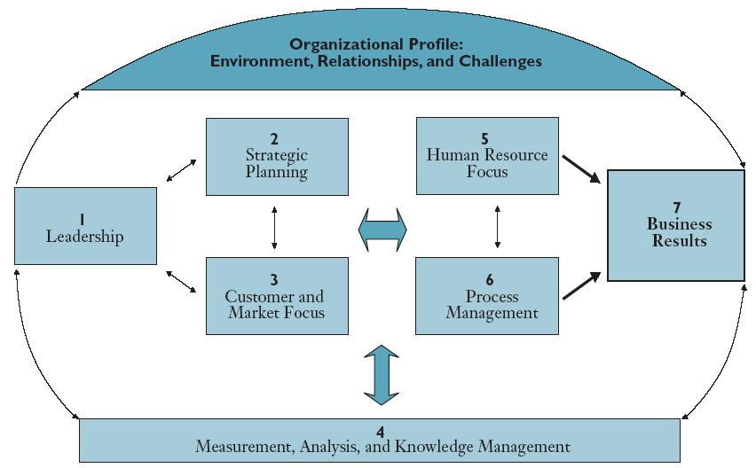
Manufacturing Excellence
85
85
450
120
85
85
90
Approach Deployment Total 550 points & Results 450 Point A balance is kept

Slide 23
The Journey To Business Excellence
876 – 1000
World Leader
751 – 875
Benchmark Leader
651 – 750
Industry Leader
551 – 650
Emerging Industry Leader
251 – 350
Early Results
451 – 550
Good Performance
351 – 450
Early Improvement
0 – 250
Early Development

Slide 24
Manufacturing Excellence
Evaluation Criteria
We have the evaluation criteria for the Business Excellence Model.
We shall be working out the evaluation criteria for Manufacturing Excellence later date

Slide 25
Thank You

